Slide 1


Slide 2
Group Members
SANIF MUJAWAR
FALADE TIMILEHIN
MEGAN WALKER
CAMILA BARROS
CHRISTOPHER MBIONWU

Slide 3
ELEVATOR PITCH
Imagine a world where your travel dreams are transformed into seamless journeys of discovery and wonder. Introducing Travel Buddy, your ultimate travel companion. With Travel Buddy, you're not just a tourist, but an explorer of hidden gems, a collector of unique experiences, and a curator of unforgettable memories. Our app empowers you to effortlessly plan, explore, and immerse yourself in the beauty of diverse cultures, breathtaking landscapes, and thrilling adventures. Whether you're seeking relaxation, adventure, or cultural enrichment, Travel Buddy has you covered. Say goodbye to travel hassles and hello to a world of seamless exploration. Elevate your journey with Travel Buddy and embark on the adventure of a lifetime!

Slide 4
Concept
All that is within the Project

Slide 5
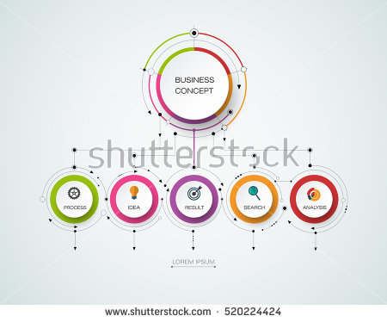
Explore Nearby
Itinerary
Travel Buddy
Maps
Popular
Destinations
Weather Forecast
Currency
Converter
Attractions

Slide 6
TRAVEL
BUDDY
ATTRACTIONS
WEATHER
CURRENCY
Geoapify
Open Weather
Exchange Rate

Slide 7
Our Product

Slide 8
Project Description:
Travel Buddy is an application that helps users efficiently plan their trips. It leverages location APIs and weather data to provide accurate information about chosen destinations. Furthermore, the app enables users to create customized itineraries, ensuring a unique and memorable travel experience.
User:
For people on a holiday or work trip in a city
For people who want to research and store their itinerary in one simple place
User Stories:
1. As a user, I want to search for destinations to get information about attractions, weather, activities and transport options for my city trip.
2. As a user, I want to receive up-to-date weather forecasts for the selected destinations.
3. As a user, I wish to be able to convert my budget to the local currency.
4. As a user, I want to save points of interest in a personalized itinerary for my trip.

Slide 9
Planning
User-Centric Design: Our planning started with creating comprehensive wireframes using tools like Figma. We envisioned the user experience from start to finish, ensuring that every feature serves the needs of our travelers.
Task Management: To keep things organized, we utilized Trello as our digital planning board. We listed tasks, assigned responsibilities, and tracked progress in a dynamic environment accessible to the entire team.
Feature Prioritization: With the plethora of exciting ideas, we applied a strategic approach by prioritizing features that add the most value. We weighed functionality against development effort to ensure a balanced and effective user experience.
Resource Allocation: Planning also involved allocating resources efficiently. We assigned team members with the skills suited to each task, ensuring that expertise and enthusiasm aligned with project needs.
Agile Iterations: Recognizing that plans can evolve, we embraced agile methodologies. We conducted regular check-ins and feedback sessions to adapt to changes and incorporate user insights, ensuring our app meets real-world demands.
Testing and Validation: Planning didn't just end with development ideas; it extended to validating concepts. We engaged in user testing and feedback loops, allowing us to refine our ideas based on real user experiences and needs.

Slide 10
API’S Used
All about the API’s….
GeoApify :- https://apidocs.geoapify.com/
Travel Buddy uses three APIs from this platform.
The Places API generates a location ID and the longitude and latitude of the user’s chosen destination.
The longitude and latitude is then passed to the Static Map API to display a simple map of the location.
The location ID is passed to the Place Details API and with the user’s selected activities from the option menu presents the data on what is available to do in the location.
OpenWeather :- https://openweathermap.org/api
Used to display a simple weather forecast for desired location - a weather Icon, the temperature in celsius and the cloud coverage.
Exchange Rates API:- https://exchangeratesapi.io/
Used to convert the users currency to the local currency. Updates the currency rate every hour and has a very extensive list of currencies to select from.

Slide 11

03
04
APPLICATIONS
Hotels
Attractions
02
05
Local Maps
Weather Forecast
01
06
Nearby Destinations
Currency Converter

Slide 12
Demo

Slide 13
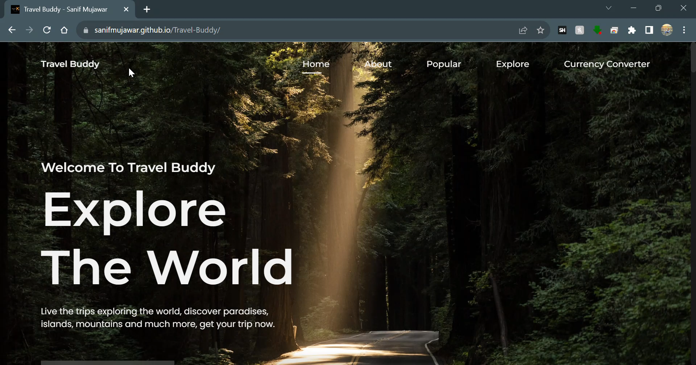

Slide 14
Future Scope
All about the Future….
Improve the scheduling system and local storage. Perhaps design an interactive calendar or diary which the user can drag and drop venues/activities onto.
Make the maps more interactive. We had hoped to be able to make place markers to show where the venues were in the location. Also potential for route planning and being able to zoom in/out on the location.
Ability to access and leave reviews from the app.
Further develop the weather data to include forecasts for the week ahead and compare forecasts if the user is still undecided about where to visit.

Slide 15
Links
Deployed Site:
https://sanifmujawar.github.io/Travel-Buddy/
Repo:
https://github.com/sanifmujawar/Travel-Buddy

Slide 16

References
Agrawal, Govind (2010). Fiber-Optic Communication Systems (4 ed.). Wiley.
Literature
Mitschke F., Fiber Optics – Physics and Technology, Springer, 2009.
Optical Fiber Communications by Gerd Keiser 4th Edition.
Russell, Philip (2003). "Photonic Crystal Fibers". Science. 299 (5605): 358–62.
Yao, S. (2003) "Polarization in Fiber Systems: Squeezing Out More Bandwidth" July 11, 2011, at the Wayback Machine., The Photonics Handbook, Laurin Publishing, p. 1.
Williams, E. A. (ed.) (2007). National Association of Broadcasters Engineering Handbook (Tenth Edition). Taylor & Francis. pp. 1667–1685 (Chapter 6.10 – Fiber–Optic Transmission Systems, Jim Jachetta).

Slide 17
That’s all. Thank you very much! ☺

